Slide 1


SOCIAL CHANGE
DR J BALAMURUGAN

Slide 2
INTRODUCTION
CHANGE IS THE NATURAL LAW.
EVERYTHING IN THIS WORLD UNDERGO CHANGES.
‘CHANGE’ IS THE ONE THING WHICH DOES NOT CHANGE.
THE WORD “CHANGE” DENOTES A DIFFERENCE IN ANYTHING OBSERVED OVER SOME PERIOD OF TIME.
SOCIAL CHANGE, MEANS OBSERVABLE DIFFERENCES IN ANY SOCIAL PHENOMENA OVER ANY PERIOD OF TIME.

Slide 3
MEANING OF SOCIAL CHANGE
IT IS MODIFICATION THAT TAKE PLACE IN THE LIFE PATTERNS OF PEOPLE.
IT DOES NOT REFER TO ALL CHANGES WHICH OCCUR IN SOCIETY.
CHANGES IN ART, LANGUAGE, TECHNOLOGY, PHILOSOPHY, ETC., ARE CANNOT BE CONSIDERED AS SOCIAL CHANGE.
SOCIAL CHANGE MEANS ALTERATIONS THAT TAKE PLACE IN SOCIAL RELATIONSHIPS.
IT INCLUDES SOCIAL PROCESS, SOCIAL PATTERNS AND SOCIAL INTERACTIONS.
SOCIAL CHANGE INCLUDES THE CHANGES IN INSTITUTIONAL AND NORMATIVE STRUCTURE OF SOCIETY.

Slide 4
DEFINITION OF SOCIAL CHANGE
M.D. JENSON – “SOCIAL CHANGE MAY BE DEFINED AS MODIFICATION IN WAY OF DOING AND THINKING OF PEOPLE”.
KOEING – “SOCIAL CHANGE REFERS TO THE MODIFICATIONS WHICH OCCUR IN THE LIFE PATTERNS OF THE PEOPLE”.
DAVIS – “SOCIAL CHANGE IS MEANT ONLY SUCH ALTERATIONS AS OCCUR IN SOCIAL ORGANIZATION THAT IS STRUCTURE AND FUNCTIONS OF SOCIETY”.
ANDERSON AND PARKER – “SOCIAL CHANGE INVOLVES ALTERATION IN THE STRUCTURE OR FUNCTIONING OF SOCIAL FORMS OR PROCESS THEMSELVES”.

Slide 5
NATURE OF SOCIAL CHANGE
SOCIAL CHANGE IS AN UNIVERSAL PHENOMENON.
SOCIAL CHANGE IS COMMUNITY CHANGE.
SPEED OF SOCIAL CHANGE IS NOT UNIFORM.
NATURE AND SPEED OF SOCIAL CHANGE IS RELATED TO TIME FACTOR.
SOCIAL CHANGE OCCURS AS AN ESSENTIAL LAW.
DEFINITE PREDICTION OF SOCIAL CHANGE IS NOT POSSIBLE.
SOCIAL CHANGE SHOW CHAIN REACTION SEQUENCE.
SOCIAL CHANGE RESULTS FROM THE INTERACTION OF A NUMBER OF FACTORS.
SOCIAL CHANGES ARE CHIEFLY THOSE OF MODIFICATION OR OF REPLACEMENT.

Slide 6
NATURE OF SOCIAL CHANGE
SOCIAL CHANGE IS AN UNIVERSAL PHENOMENON.
  SOCIAL CHANGE OCCURS IN ALL SOCIETIES.
  NO SOCIETY REMAINS COMPLETELY STATIC.
  THIS IS TRUE OF ALL SOCIETIES, PRIMITIVE AS WELL AS CIVILIZED SOCIETIES.
SOCIAL CHANGE IS COMMUNITY CHANGE.
  ITS NOT ONLY CHANGE IN THE LIFE OF INDIVIDUAL.
  IT IS A CHANGE WHICH OCCURS IN THE LIFE OF THE ENTIRE COMMUNITY.
SPEED OF SOCIAL CHANGE IS NOT UNIFORM.
  ITS SPEED NOT UNIFORM.
  SOCIAL CHANGE IN URBAN AREAS IS FASTER THAN IN RURAL AREAS.
NATURE AND SPEED OF SOCIAL CHANGE IS RELATED TO TIME FACTOR.
  IN MODERN TIMES THE SPEED OF SOCIAL CHANGE IS FASTER TODAY THAN BEFORE 1947.

Slide 7
NATURE OF SOCIAL CHANGE
SOCIAL CHANGE OCCURS AS AN ESSENTIAL LAW.
  CHANGE IS THE LAW OF NATURE. SOCIAL CHANGE ALSO IS NATURAL.
  CHANGE HAS BECOME HAS A WAY OF LIFE.
DEFINITE PREDICTION OF SOCIAL CHANGE IS NOT POSSIBLE.
  IT IS DIFFICULT TO MAKE ANY PREDICTION ABOUT THE EXACT FORMS OF SOCIAL CHANGE.
  IT CANNOT BE PREDICTED AS TO WHAT SHALL BE OUR ATTITUDES, IDEAS, NORMS AND VALUES IN FUTURE.
SOCIAL CHANGE SHOW CHAIN REACTION SEQUENCE.
  SOCIETY’S PATTERN OF LIVING IS A DYNAMIC SYSTEM OF INTER-RELATED PARTS.
  INDUSTRIALIZATION LEADS URBANIZATION, CHANGE FAMILY STRUCTURE, WOMEN EMPOWERMENT, INDIVIDUALITY ETC.,

Slide 8
NATURE OF SOCIAL CHANGE
SOCIAL CHANGE RESULTS FROM THE INTERACTION OF A NUMBER OF FACTORS.
  IT IS THOUGHT THAT A PARTICULAR FACTOR LIKE CHANGES IN TECHNOLOGY, ECONOMIC DEVELOPMENT OR CLIMATIC CONDITIONS CAUSES OF SOCIAL CHANGE.
SOCIAL CHANGES ARE CHIEFLY THOSE OF MODIFICATION OR OF REPLACEMENT.
  IT MAY BE MODIFICATION OF PHYSICAL GOODS OR SOCIAL RELATIONSHIPS. (E.G.) OUR BREAKFAST FOOD HAS CHANGED.
  OUR IDEAS ABOUT WOMEN’S RIGHTS, RELIGION, GOVERNMENT AND CO-EDUCATION STAND MODIFIED TODAY.
  OUR IDEAS HAVE BEEN REPLACED BY NEW IDEAS. (E.G) MEDICINE, AUTOMOBILES ETC.,

Slide 9

FACTORS INFLUENCING SOCIAL CHANGE
BIOLOGICAL FACTORS
PHYSICAL FACTORS
TECHNOLOGICAL FACTORS
CULTURAL FACTORS
SANSKRITIZATION
INDUSTRIALIZATION
MODERNIZATION
SOCIAL REFORMERS
SOCIAL PLANNING
WESTERNIZATION
URBANIZATION

Slide 10
BIOLOGICAL FACTORS
THE BIOLOGICAL FACTORS INCLUDE
  (I) THE PLANTS AND ANIMALS IN THE AREA.
  (II) HUMAN BEINGS THEMSELVES.
THE NON-HUMAN BIOLOGICAL ENVIRONMENT AFFECTS HUMAN, SOCIAL AND CULTURAL LIFE.
CHANGES IN GEOGRAPHIC CONDITIONS SUCH AS
  CHANGE IN CLIMATE, CHANGE IN SOIL COMPOSITION, DRYING UP OF LAKES, STREAMS KILL SOME ORGANISMS AND GIVE BIRTH TO OTHERS.
THOSE CHANGES AFFECT THE NATURE OF MAN’S STRUGGLE FOR EXISTENCE.
SIMILARLY, CHANGES IN THE POPULATION ARE CAUSE A NUMBER OF CHANGES IN SOCIAL RELATIONS.

Slide 11
PHYSICAL FACTORS
THERE ARE SLOW GEOGRAPHICAL CHANGES AS WELL AS THE OCCASIONAL CHANGES OF NATURE OF STORM, EARTHQUAKES, FLOODS AND SEASONAL CHANGES WHICH RAISE AND SUBMERGE PORTIONS OF THE EARTH’S SURFACE.
THE CHANGES IN THE PHYSICAL ENVIRONMENT SOMETIMES BRING ABOUT IMPORTANT CHANGES IN SOCIETY.
THE GREAT VOLCANIC ERUPTION OF YAKOHAMA IN 1923 WAS RESPONSIBLE FOR THE NEW KIND OF ARCHITECTURE IN JAPAN.
IN THE MORE TEMPERATE CLIMATES ALSO RAPID CHANGES IN SOCIETY.

Slide 12
TECHNOLOGICAL FACTORS
TECHNOLOGY AFFECTS SOCIETY GREATLY IN THAT A VARIATION IN TECHNOLOGY CAUSES A VARIATION IN SOME INSTITUTION OR SOME CUSTOM.
MECHANIZATION HAS CHANGED NOT ONLY THE ECONOMIC STRUCTURE OF SOCIETY BUT HAS ALSO CHANGES OF OLD FORM OF SOCIAL ORGANIZATION AND OLD IDEOLOGIES.
MODERN TECHNOLOGY HAS BROUGHT CHANGES IN THE
  AGRICULTURAL TECHNIQUES, THE MEANS OF COMMUNICATION, THE MEANS OF TRANSPORTATION, ETC.,
WHENEVER A CHANGE HAS OCCURRED IN THE ELEMENT OF A SYSTEM OF TECHNIQUES, THE ENTIRE SYSTEM WAS DISTURBED WHICH LED TO CHANGES IN ALL ITS ELEMENTS.

Slide 13
CULTURAL FACTORS
OGBURN DISTINGUISHES BETWEEN ‘MATERIAL CULTURE’ AND ‘NON-MATERIAL CULTURE’.
THE MATERIAL ASPECT OF CULTURE INCLUDES THINGS, TOOLS, UTENSILS, MACHINES, RESIDENCES, THE MANUFACTURE OF GOODS AND TRANSPORTATION.
THE NON-MATERIAL ASPECT OF CULTURE INCLUDES BELIEF, ATTITUDE, FAMILY, RELIGION, GOVERNMENT AND EDUCATION.
A CULTURE PROMPTS AND DIRECTIONS TO SOCIAL BEHAVIOUR. SO WHENEVER THERE IS A CHANGE IN CULTURAL ELEMENTS, IT BRINGS CHANGE IN SOCIAL BEHAVIOUR.

Slide 14
INDUSTRIALIZATION
INDUSTRIALIZATION HAS AFFECTED THE SOCIETY IN EVERY ASPECT.
THE CUSTOMS AND TRADITIONS, THE FASHION AND MANNERS, THE WAYS AND MODES OF LIVING ALL HAVE BEEN DEEPLY INFLUENCED BY INDUSTRIALIZATION.
THE OLD VALUES AND RULES RELATING TO RELIGION AND MORALS ARE UNDERGOING RADICAL CHANGES.
THE CASTE SYSTEM IS BEING REPLACED BY CLASS SYSTEM.
EVEN THE MEANS OF RECREATION AND ENTERTAINMENT ARE UNDERGOING CHANGE.
THE ANCIENT INSTITUTIONS OF MARRIAGE AND FAMILY HAVE ALSO CHANGED.

Slide 15
URBANIZATION
URBANIZATION CONCERNS THE MOVEMENT OF POPULATION FROM AGRICULTURAL TO INDUSTRIAL WORK AND FROM RURAL TO URBAN PLACES OF RESIDENCE.
FOR MOST SUCH IMMIGRANTS, URBANIZATION MEANS A SOURCE OF CHANGE FROM ONE WAY OF LIFE TO ANOTHER.
AS SUCH NEW CLASSES AND STATUS FUNCTIONS ARE DERIVED IN SOCIAL LIFE.
NEW FORMS OF MASS MEDIA LIKE THE RADIO, T.V., NEWSPAPERS, MAGAZINES ETC., BRING A LOT OF CHANGE IN RURAL SOCIAL LIFE.

Slide 16
SOCIAL REFORMERS
THE SOCIAL REFORMERS HAVE PLAYED A VERY SIGNIFICANT ROLE IN BRINGING OUT CHANGE IN THE SOCIAL, CULTURAL, POLITICAL, LITERARY AND CHIEFLY THE RELIGIOUS ASPECT OF LIFE IN INDIA.
THERE WERE MANY SOCIAL REFORMERS VIZ, RAJA RAM MOHAN RAI, KESHAVA CHANDRA SEN, DAYANANDA SARASWATI, RAMAKRISHNA PARAMHANSA, E.V.RAMASAMY NAICKER, DR.AMBEDKAR AND OTHERS.
THE ROLE OF THESE REFORMERS IN THE FIELD OF SOCIAL, CULTURAL, POLITICAL AND RELIGIOUS LIFE ARE MORE SIGNIFICANT WHICH HAVE BROUGHT TREMENDOUS CHANGE IN SOCIAL LIFE OF PEOPLE IN INDIA.

Slide 17
SOCIAL PLANNING
THESE PLANS ARE AIMED AT NOT ONLY ECONOMIC PLANNING BUT ALSO SOCIAL PLANNING.
THE GOVERNMENT OF INDIA APPOINTED A PLANNING COMMISSION IN 1950 TO PREPARE A BLUEPRINT OF DEVELOPMENT TAKING AN OVERALL VIEW OF THE NEEDS AND RESOURCES OF THE COUNTRY.
ALL THE TWELVE FIVE YEAR PLANS TILL TODAY AIMED AT BRINGING OUT THE CHANGES IN VARIOUS ASPECTS OF THE TIME BOUND NEEDS OF THE COUNTRY.
SEVERAL PLANS ARE BEING FORMULATED TO BRING DESIRED CHANGES IN VARIOUS ASPECTS OF SOCIAL LIFE. BUT THE NATURE OF OUR SOCIETY IS TOTALLY DIFFERENT WHICH NEEDS MORE SYSTEMATIC APPROACH TO ACHIEVE THE CHANGE.

Slide 18
THEORIES OF SOCIAL CHANGE
VARIOUS THEORIES HAVE BEEN ADVANCED TO EXPLAIN THE DIRECTION OF SOCIAL CHANGE. WE TAKE A BRIEF CONSIDERATION OF THE FOLLOWING POPULAR THEORIES:
  1. LINEAR THEORY.
  2. CYCLICAL THEORY.
  3. MARXIAN THEORY
  4. FUNCTIONAL THEORY.

Slide 19
LINEAR THEORY
SOCIETY GRADUALLY MOVES TO AN EVEN HIGHER STATE OF CIVILIZATION AND THAT IT ADVANCES IN A LINEAR FASHION AND IN THE DIRECTION OF IMPROVEMENT.
AUGUSTE COMTE POSTULATED THREE STAGES OF SOCIAL CHANGE:
  THE THEOLOGICAL - THE METAPHYSICAL - THE POSITIVE.
ACCORDING TO HIM, IN THE FIRST STAGE MAN BELIEVED THAT SUPERNATURAL POWERS CONTROLLED AND DESIGNED THE WORLD.
THE SECOND STAGE, DURING WHICH MAN TRIED TO EXPLAIN PHENOMENA BY THOUGHTS.
ON THE POSITIVE STAGE MAN CONSIDERS THE SEARCH FOR ULTIMATE CAUSES HOPELESS AND SEEKS THE EXPLANATORY FACTS THAT CAN BE EMPIRICALLY OBSERVED.

Slide 20
CYCLICAL THEORY
SOCIETY AFTER PASSING THROUGH ALL THE STAGES, RETURNS TO THE ORIGINAL STAGE, WHEN THE CYCLE AGAIN START ON.
SPENGLER, BELIEVE THAT ALL THE CIVILIZATIONS PASS THROUGH A SIMILAR LIFE CYCLE THAT IS BIRTH, MATURITY, AND DEATH.
IN RECENT TIMES ARNOLD J TOYNBEE, THE NOTED ENGLISH HISTORIAN, HAS ALSO PROPOUNDED A CYCLICAL THEORY OF THE HISTORY OF WORLD CIVILIZATION.
HE MAINTAINED THAT CIVILIZATIONS PASS THROUGH THREE STAGES, CORRESPONDING TO YOUTH, MATURITY AND DECLINE.
THE FIRST IS MARKED BY A “RESPONSE TO CHALLENGE”, THE SECOND IS A “TIME OF TROUBLES” AND THE THIRD IS CHARACTERIZED BY “GRADUAL DEGENERATION”.

Slide 21
MARXIAN THEORY
KARL MARX NOTED THAT CHANGE FROM ONE STAGE TO ANOTHER IS DUE TO CHANGES IN THE ECONOMIC FACTORS, NAMELY, THE METHODS OF PRODUCTION AND DISTRIBUTION.
THE MODE OF PRODUCTION IN MATERIAL LIFE DETERMINES THE GENERAL CHARACTER OF LIFE SOCIAL, POLITICAL AND SPIRITUAL PROCESS OF LIFE.
THE ECONOMIC FACTOR IS A PRIMARY ONE IN SOCIETY, FOR ALL SOCIAL PHASES OF LIFE ARE DEPENDENT UPON IT AND ARE ALMOST ENTIRELY DETERMINED BY IT.
A CHANGE IN THE MATERIAL CONDITIONS OF LIFE BRINGS CHANGES IN ALL SOCIAL INSTITUTIONS, SUCH AS STATE, RELIGION AND FAMILY.

Slide 22
FUNCTIONAL THEORY
IN OUR SOCIAL LIFE, WE HAVE SOCIAL INSTITUTIONS LIKE EDUCATION, FAMILY, ECONOMIC, POLITICAL, MARRIAGE, RELIGION ETC.,
THESE ALL ARE SEGMENTS IN OUR SOCIETY.
SO IN A SOCIETY ALL PARTS ARE INTER-RELATED.
AS LONG AS THEY FUNCTIONS WELL THERE IS A STABILITY IN SOCIETY, WHEN THEY DO NOT FUNCTIONS OR ONE PART DO NOT FUNCTIONS WELL THEN ALL OTHER PARTS ARE AFFECTED AN THEN SOCIAL CHANGE OCCUR.

Slide 23
WESTERNISATION
AND
URBANISATION
DR J BALAMURUGAN

Slide 24
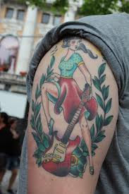

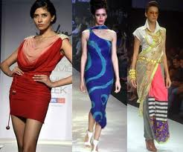


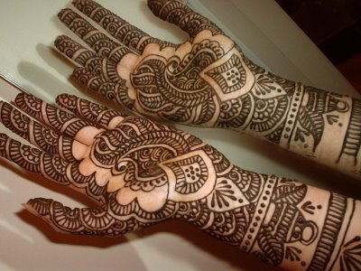
WESTERNISATION

Slide 25
INTRODUCTION
THE ROLE ‘WESTERNISATION’ HAS BEEN VERY SIGNIFICANT IN UNDERSTANDING THE SOCIO-CULTURAL CHANGES OF MODERN INDIA.
BRITISH RULE PRODUCED RADICAL AND LASTING CHANGES IN THE INDIAN SOCIETY AND CULTURE.
THE BRITISH BROUGHT WITH THEM, NEW TECHNOLOGY, INSTITUTIONS, KNOWLEDGE, BELIEFS AND VALUES.
THESES HAVE BECOME THE MAIN SOURCE OF SOCIAL MOBILITY FOR INDIVIDUAL AS WELL AS GROUPS.

Slide 26
MEANING
M.N. SRINIVAS (1962) PIONEER OF SOCIOLOGY IN INDIA HAS USED THE TERM ‘WESTERNISATION’ TO INDICATE THE CHANGE, WHICH TOOK PLACE IN INDIA DURING THE BRITISH RULE IN THE 19TH AND EARLY 20TH CENTURIES.
WESTERNISATION IMPLIES CHANGES IN DRESS STYLE, EATING, MANNERS ETC. THE CHANGE IN THE MEDIUM OF INSTRUCTION.
IT STARTED HAVING ITS IMPACT ON THE ELITE BECAUSE THEY STUDIED SECULAR SUBJECTS WITH ENGLISH AS MEDIUM OF INSTRUCTION.
AS MUCH AS MODERNISATION IN INDIA HAS COME ABOUT DUE TO WESTERNISATION.

Slide 27
FEATURES OF WESTERNISATION
IN COMPARISON WITH SANSKRITISATION, WESTERNISATION IS A SIMILAR CONCEPT.
IT IMPLIES AN ACTIVE CONCERN FOR THE WELFARE OF ALL HUMAN BEINGS.
IT NOT ONLY INCLUDES OF NEW INSTITUTIONS BUT ALSO FUNDAMENTAL CHANGES IN OLD INSTITUTIONS.
THE FORM OF PACE OF WESTERNISATION OF INDIA VARIED FROM REGION TO REGION AND FROM ONE SECTION OF POPULATION TO ANOTHER.
IT PERVADES POLITICAL AND EDUCATIONAL FIELDS ALSO.

Slide 28
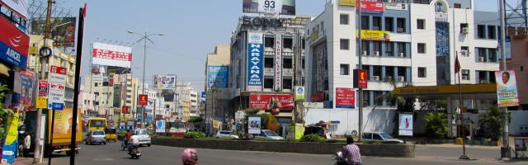
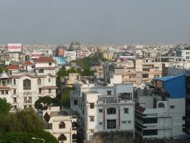
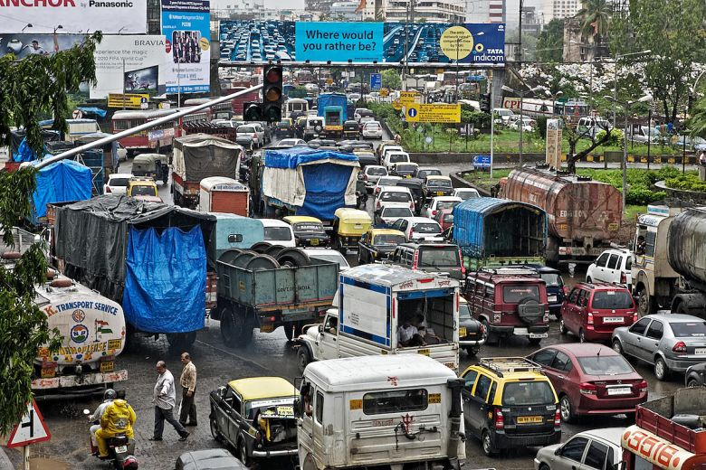
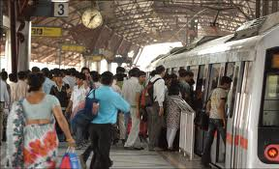
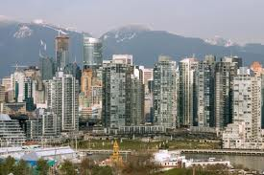
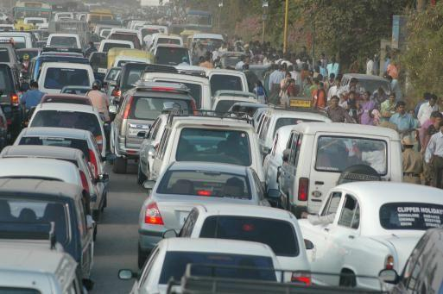
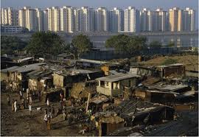
URBANISATION

Slide 29
INTRODUCTION
WHAT IS AN ‘URBAN AREA’?
THE TERM IS USED IN TWO SENSES –
  DEMOGRAPHICALLY, THE FOCUS IS ON THE SIZE AND DENSITY OF POPULATION AND NATURE OF WORK OF THE MAJORITY OF THE ADULT MALES.
  SOCIOLOGICALLY, THE FOCUS IS ON HETEROGENEITY, IMPERSONALITY, INTERDEPENDENCE AND THE QUALITY OF LIFE.

Slide 30
CLASSIFICATION OF URBAN
IN CENSUS OF INDIA, TWO TYPES OF TOWN WERE IDENTIFIED
  A) STATUTORY TOWNS: ALL PLACES WITH A MUNICIPALITY, CORPORATION, CANTONMENT BOARD OR NOTIFIED TOWN AREA COMMITTEE, ETC. SO DECLARED BY STATE LAW.
  B) CENSUS TOWNS: PLACES WHICH SATISFY FOLLOWING CRITERIA :-
    I) A MINIMUM POPULATION OF 5000
    II) AT LEAST 75% OF MALE WORKING POPULATION ENGAGED IN NON AGRICULTURAL OCCUPATION
    III) A DENSITY OF POPULATION OF AT LEAST 400 PERSONS PER SQ KM

Slide 31
MEANING
URBANIZATION CONCERNS THE MOVEMENT OF POPULATION FROM AGRICULTURAL TO INDUSTRIAL WORK AND FROM RURAL TO URBAN PLACES OF RESIDENCE.
PEOPLE ARE ATTRACTED TO THE CITY BY VISION OF A BETTER LIFE, OR THEY FEEL COMPELLED TO LEAVE RURAL PLACES BECAUSE THEY ARE DISADVANTAGED THERE.
AS SUCH NEW CLASSES AND STATUS FUNCTIONS ARE DERIVED IN SOCIAL LIFE. NEW FORMS OF MASS MEDIA LIKE THE RADIO, T.V., NEWSPAPERS, MAGAZINES ETC., BRING A LOT OF CHANGE IN RURAL SOCIAL LIFE.

Slide 32
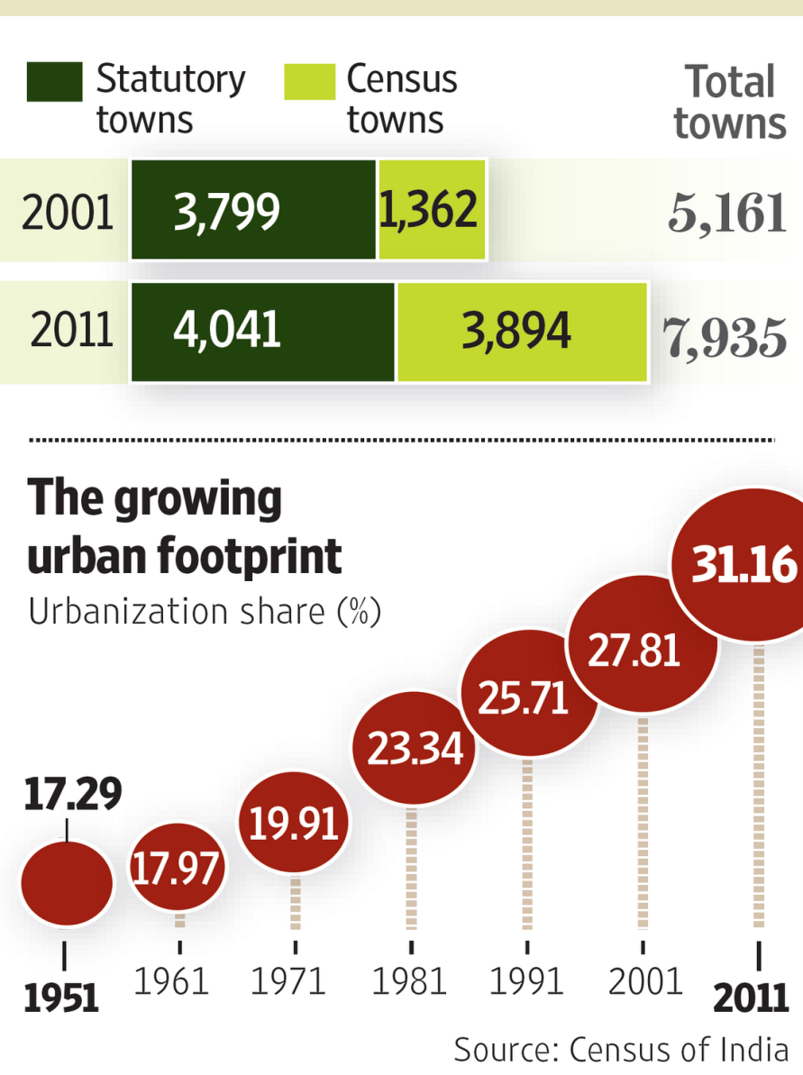
LEVEL OF URBANISATION IN INDIA

Slide 33
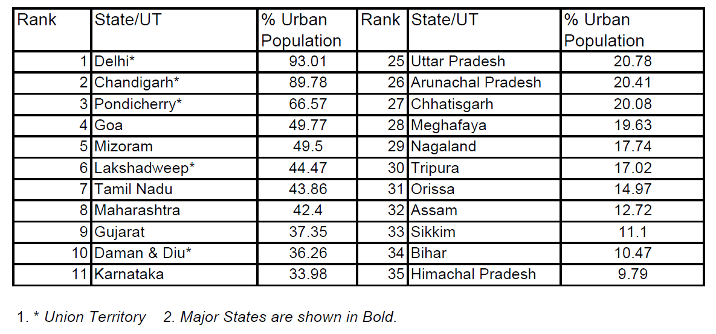
RANKING OF STATES BY LEVEL OF URBANISATION

Slide 34
GROWTH OF CITIES
SURPLUS RESOURCES
INDUSTRIALISATION AND COMMERCIALISATION
DEVELOPMENT OF TRANSPORT AND COMMUNICATION
ECONOMIC PULL OF THE CITY
EDUCATIONAL AND RECREATIONAL FACILITIES

Slide 35
IMPACT OF URBANISATION
THE MULTICULTURALISM OF TODAY'S CITIES CONTRIBUTES TO INCREASED TOLERANCE, BETTER QUALITY OF LIFE, AND SOCIO-CULTURAL MOTIVATION;
AT THE SAME TIME, IT OFTEN CONTRIBUTES TO SOCIAL TENSIONS, INTERETHNIC DETERMINED AND CULTURAL CONFLICTS.
PEOPLE COMING FROM RURAL AREAS HAVE BEEN SUFFER FROM THE ISOLATION, LACK OF TECHNOLOGIC CONNECTION, POOR HEALTH, POVERTY, UNEMPLOYMENT AND INADEQUATE HOUSING IN URBAN.
URBANIZATION IS ENCOURAGED SOCIALLY AND CULTURALLY THROUGH THE MEDIA.
ALL OF WHICH UNDOUBTEDLY CREATE THE PSYCHO-SOCIO PROBLEMS AMONG PEOPLE.

Slide 36
THANK YOU

